Slide 1
Penguin Species Classification Memo
A Preserved Penguin Specimen Has Bill Length = 45 mm And Flipper Length = 220 mm.
What Species Is It Most Likely To Be, And How Confident Are We?
Prepared for: Dr. Anya Sharma
Prepared by: Tran Quoc Bao Dang (STAT-692)

Slide 2

Executive Summary
Key Finding: The unidentified specimen is most likely a Gentoo penguin.
Evidence:
Visual comparison
Species measurement comparison
Statistical classification
Confidence: 99.96% probability of Gentoo

Slide 3

Client Problem
- A preserved penguin specimen lost its identification tag.
- Available measurements:
Bill length = 45 mm
Flipper length = 220 mm
- Client Questions:
1. What species is it?
2. How confident are we?
3. How does it compare to known species?

Slide 4
Data Used
Palmer Penguins Dataset
342 penguins
151 Adelie
68 Chinstrap
123 Gentoo
Measurements:
Bill length
Flipper length
Kaggle: https://www.kaggle.com/datasets/parulpandey/palmer-archipelago-antarctica-penguin-data
R-Project: https://cran.r-project.org/web/packages/palmerpenguins/readme/README.html

Slide 5
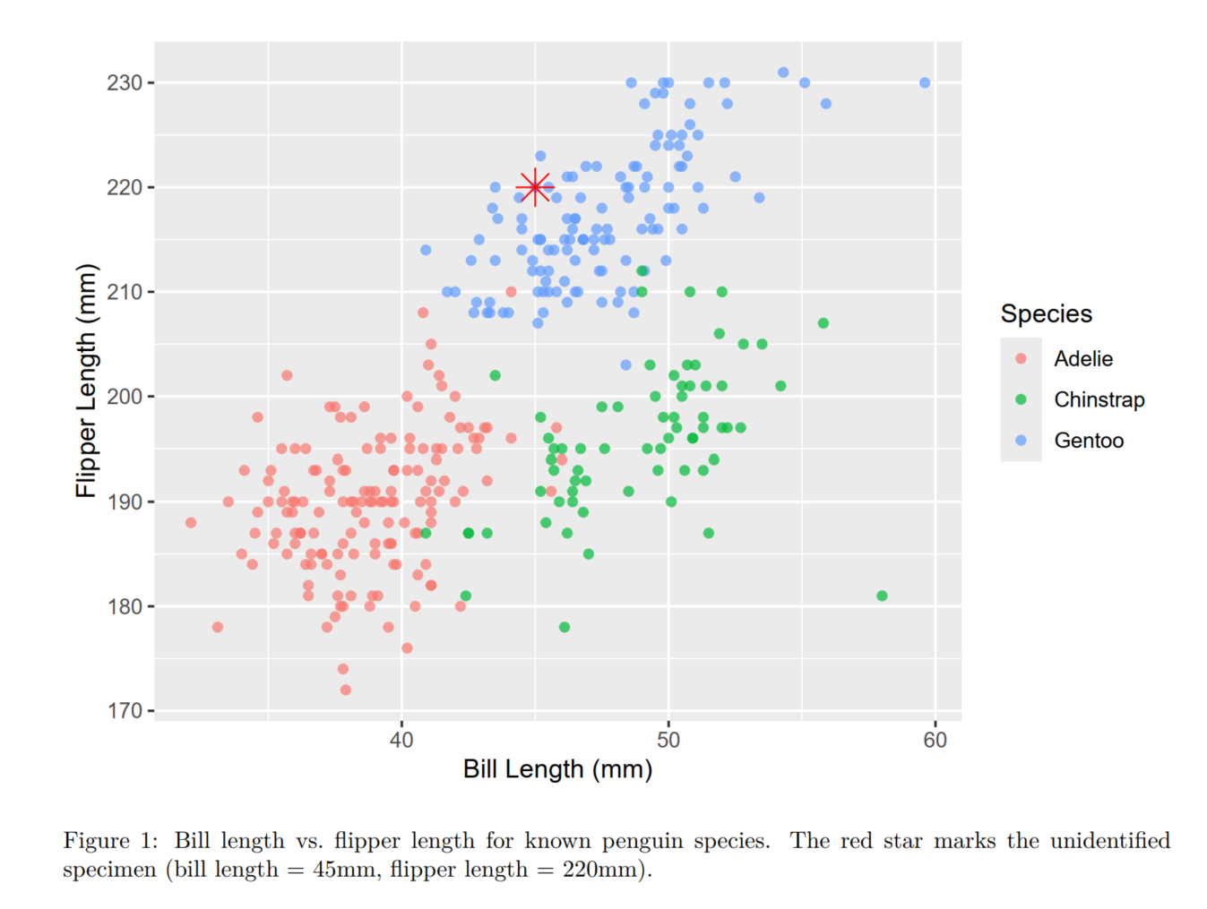
Visual Evidence
Figure 1 shows the relationship between bill length and flipper length for the three species.
The unidentified specimen falls directly within the Gentoo cluster and is visually separated from most Adelie and Chinstrap observations.

Slide 6
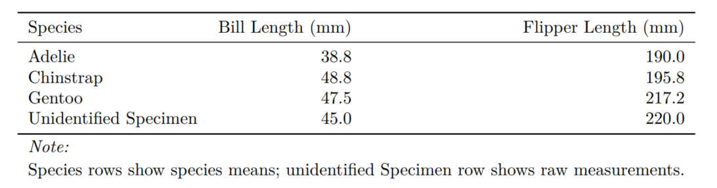
Comparison of Measurements
=> Closest Match: Gentoo

Slide 7

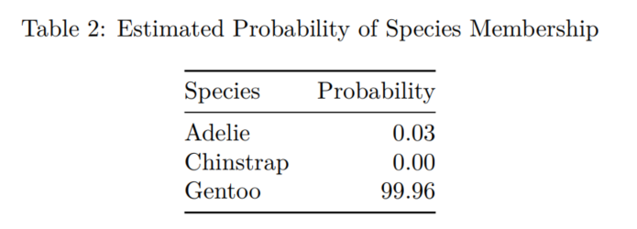
Confidence Assessment
Statistical analysis indicates: Gentoo received a probability of 99.96%, while the other species received essentially zero probability.

Slide 8

Limitations
Potential sources of uncertainty:
Only two measurements available (bill length, flipper length)
Preserved specimen may contain measurement error
Other biological characteristics unavailable (body mass, bill depth, sex, island of origin)

Slide 9

Recommendation
Classify the specimen as a Gentoo penguin.
Supporting evidence:
Visual comparison
Species averages
Statistical classification
Confidence: 99.96%

Slide 10
Thank you

